Slide 1
Chronos: Learning the Language of Time Series
Exploring Challenges, Architecture, and Insights
Osama Sayah
29/1/2025

Slide 2
Introduction
What is Time Series Forecasting? Time series forecasting is predicting future values based on past data that is collected over time in a sequence (e.g., daily stock prices, hourly temperature readings, or monthly sales figures).
Why is it Important? It helps businesses and organizations make informed decisions by predicting demand, trends, or potential issues. For example:
Retail: Predicting product demand to manage inventory.
Finance: Forecasting stock prices for investment decisions.
Energy: Estimating electricity usage to avoid blackouts.
Weather: Predicting storms or rainfall to prepare for emergencies.
Accurate forecasting saves resources, reduces risks, and improves efficiency.

Slide 3
Different Time Series Forecasting Models
1. Statistical Models (Simple, interpretable, best for small datasets)
ARIMA (AutoRegressive Integrated Moving Average) – Uses past values and errors to predict future trends.
ETS (Exponential Smoothing) – Gives more weight to recent observations, useful for trend & seasonality.
STL Decomposition – Breaks data into trend, seasonality, and noise components.
2. Machine Learning Models (Handles complex relationships, needs feature engineering)
XGBoost & LightGBM – Gradient boosting models that learn patterns from multiple features.
Random Forest – Decision tree-based model capturing nonlinear trends in multivariate data.
3. Deep Learning Models (Best for large datasets, long-term forecasting, handles complex dependencies)
RNNs (Recurrent Neural Networks) – Captures sequential dependencies but struggles with long-term patterns.
LSTMs (Long Short-Term Memory) – Overcomes RNN limitations by remembering long-term dependencies.
GRUs (Gated Recurrent Units) – Faster alternative to LSTMs, balances accuracy & efficiency.
Transformers (TFT - Temporal Fusion Transformer) – State-of-the-art model using attention mechanisms for complex dependencies.
4. AutoML-Based Models (Automates model selection & tuning, easy to use)
Facebook Prophet – Designed for business forecasting with easy parameter tuning.

Slide 4
Challenges in Time Series Forecasting
Non-Stationarity: Time series data often exhibit trends and seasonal patterns that change over time, making it difficult to model accurately.
Noise and Distorted Signals: Random fluctuations or 'noise' can obscure underlying patterns, leading to imprecise forecasts.
Data Sparsity and Missing Values: Incomplete or sparse data can hinder the development of reliable forecasting models.
High Dimensionality: Managing and analyzing large volumes of time series data can be computationally intensive and complex.
Model Selection and Overfitting: Choosing the appropriate model is crucial, as overfitting can lead to poor predictive performance on unseen data.
Computational Complexity: Advanced models, especially those involving deep learning, can be resource-intensive and require significant computational power.

Slide 5
Introducing Chronos
Chronos is a family of pretrained time series forecasting models based on language model architectures. A time series is transformed into a sequence of tokens via scaling and quantization, and a language model is trained on these tokens using the cross-entropy loss. Once trained, probabilistic forecasts are obtained by sampling multiple future trajectories given the historical context. Chronos models have been trained on a large corpus of publicly available time series data, as well as synthetic data generated using Gaussian processes.

Slide 6
Architecture of Chronos

Slide 7
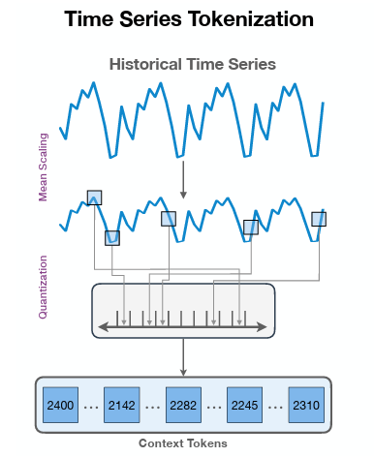
tokenization:
Mean Scaling:
Scaling normalizes the time series data to reduce outliers and ensure consistency.
Quantization:
Normalized data is divided into intervals, each representing a value range and assigned specific tokens.
Context tokens:
These tokens represent the historical data and serve as the input for the model.
Tokens in Chronos are not sequential because they represent quantized ranges of normalized data rather than specific data points.

Slide 8
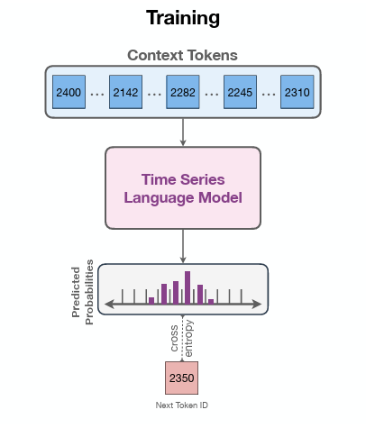
training:
Chronos uses a modified T5 (a text to text transformer model). T5 treats every problem as a text to text problem which allows it to process and predict sequences effectively.
The predicted probabilities represent the likelihood of each possible next token in the sequence.
Cross entropy is the loss function used to measure the difference between the predicted probabilities of the next token and the actual next token in the sequence.
Next token refers to the token the model predicts as the next token in the sequence based on the highest predicted probability.

Slide 9
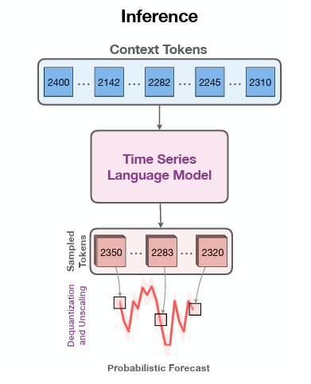
inference:
Sample tokens are tokens that are forecasted.
The sample tokens are then dequantized and unscaled back to their original form which produces the final probabilistic forecast.
Probabilistic forecasting generates multiple future trajectories, providing a comprehensive view of potential outcomes for better decision-making.

Slide 10
Key Features of Chronos
Pretrained Language Models for Time Series:
Chronos adapts the transformer architecture, originally designed for natural language processing, to forecast time series.
It tokenizes time series into discrete bins, enabling existing language models to process sequential numerical data.
Zero-shot Forecasting:
Chronos excels in predicting future values for unseen datasets without requiring task-specific fine-tuning.
Its ability to generalize makes it a powerful tool across diverse domains like retail, finance, and energy.
Probabilistic Forecasting:
Instead of predicting point values, Chronos provides probabilistic forecasts, capturing the uncertainty in predictions.
Integration with Large-scale Datasets:
The model is trained on a mix of public datasets and synthetic data generated via advanced augmentation techniques, enhancing its robustness and accuracy.
Efficient Design:
By using scaling and quantization, Chronos transforms time series into a "language" that pretrained models can interpret. This approach minimizes the need for architecture-specific changes.

Slide 11
Insights and takeaways

